Slide 1

ALLUXIO

Slide 2
OUTLINE
Big data ecosystem before and now
What is alluxio?
Need of alluxio
Architecture of alluxio
When to use and its benefits
Features
Tiered storage
Unified namespace
Transparent naming

Slide 3
Dataflow in alluxio
Installations
Demo

Slide 4
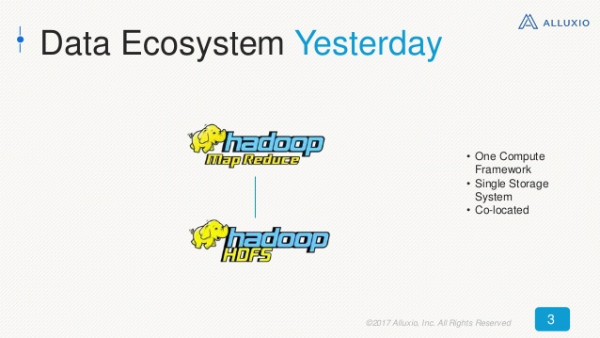

Slide 5
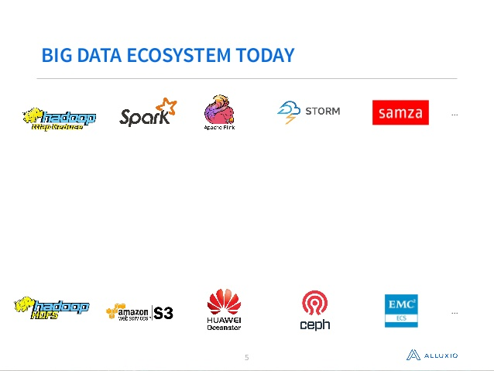

Slide 6
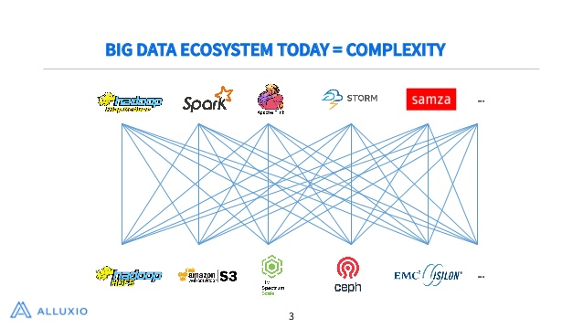

Slide 7
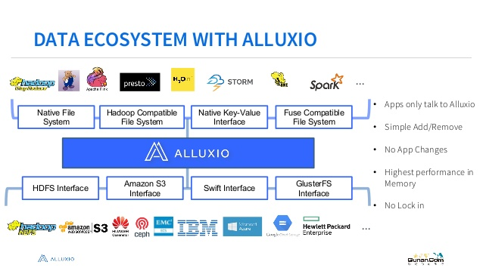

Slide 8
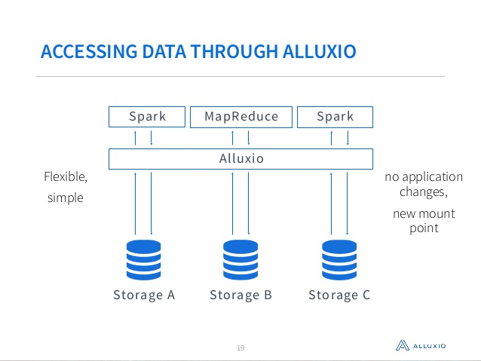

Slide 9
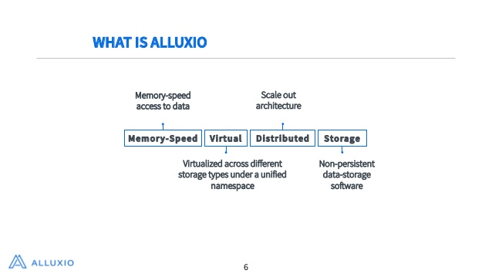

Slide 10
WHAT IS ALLUXIO?
It is open source memory speed virtual distributed storage
It is fastest growing OS project in big data ecosystem
Applications only need to connect with Alluxio to access data stored in any underlying storage systems

Slide 11
It became the de facto storage unification layer for big data and other scale
It enables virtualized data across multiple types of storage

Slide 12
ORIGIN OF ALLUXIO?
Started at UC Berkeley AMPLab in 2012
Formerly known as Tachyon
CEO is Haoyan Li
First version of alluxio was built during 2012 and open sourced in 2013
2 years later alluxio was founded
It has over 250 contibutors like AliBaba, Baidu, IBM,Intel etc.

Slide 13
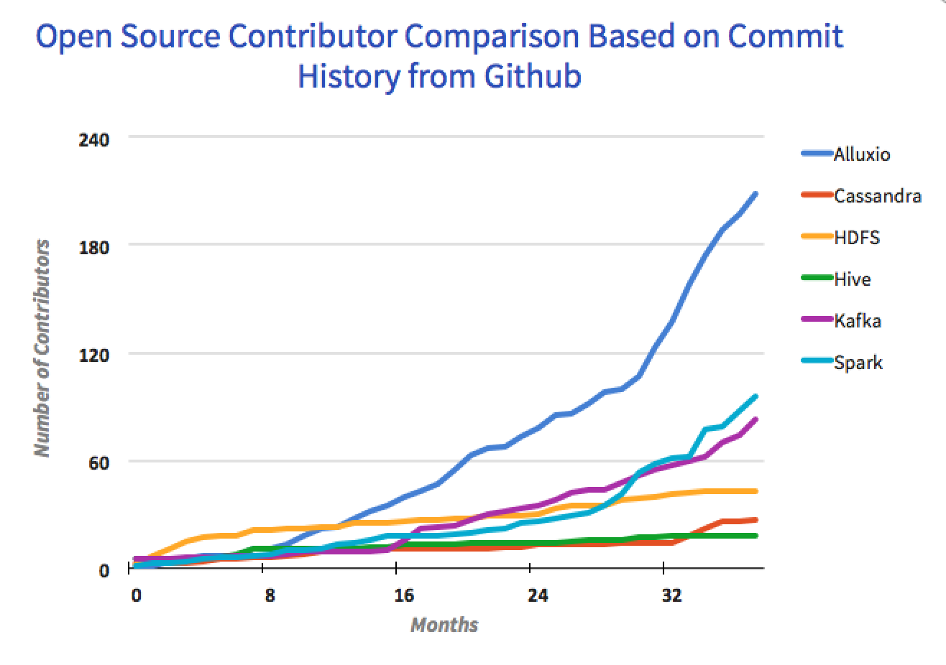
Alluxio open source contributor growth
Over 250 contributions from over 100 organizations.
3x growth over last
year.

Slide 14
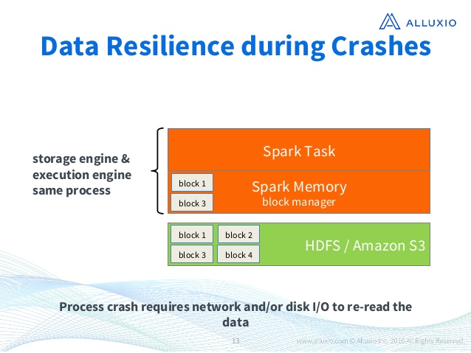
WHY TO USE ALLUXIO?
Data resiliance during application crashes

Slide 15
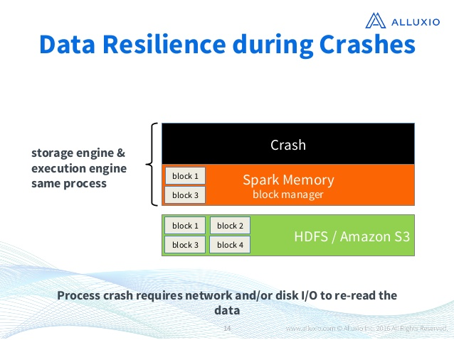

Slide 16
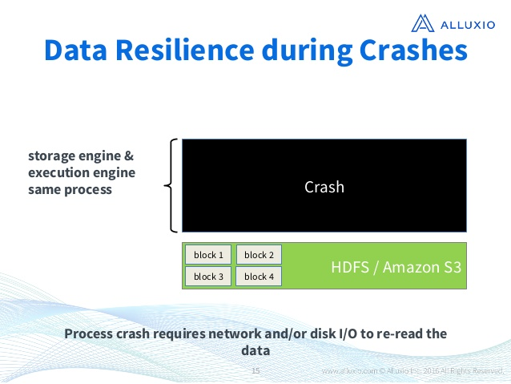

Slide 17
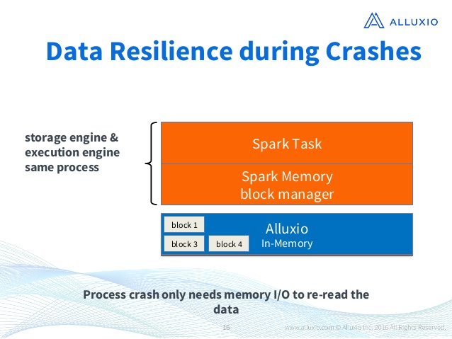

Slide 18
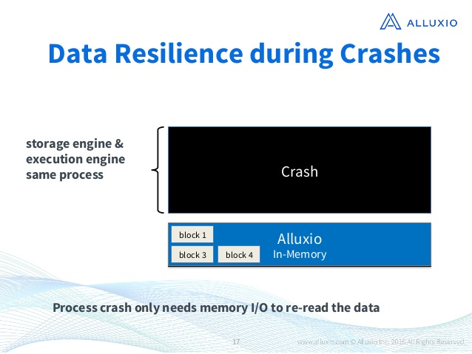

Slide 19
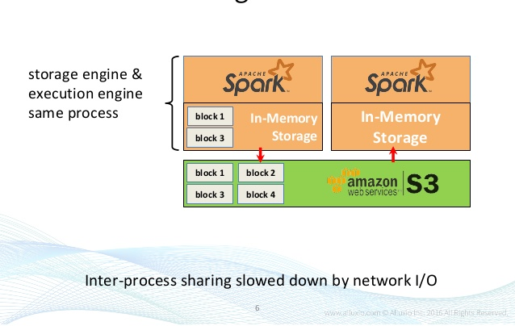
Data sharing between jobs

Slide 20
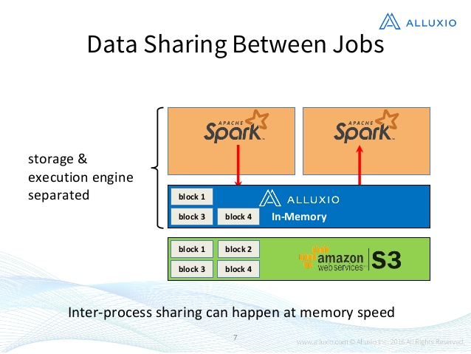

Slide 21
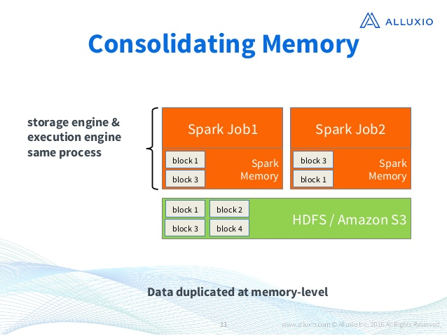
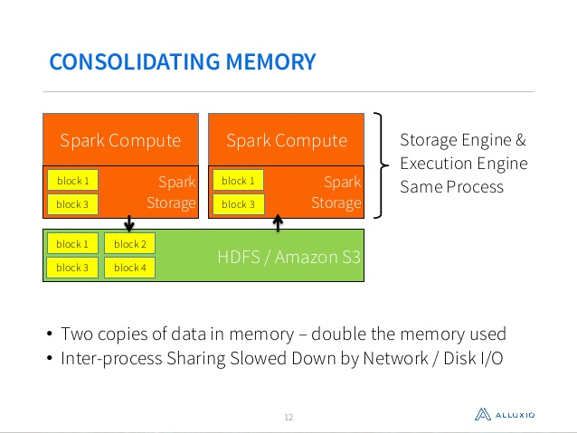
Consolidate memory usage and alleviate GC (garbage collection) issues

Slide 22
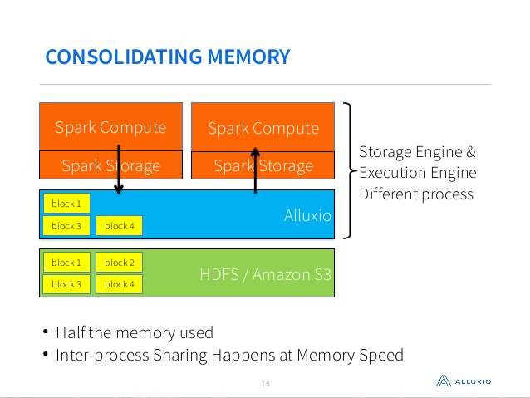

Slide 23
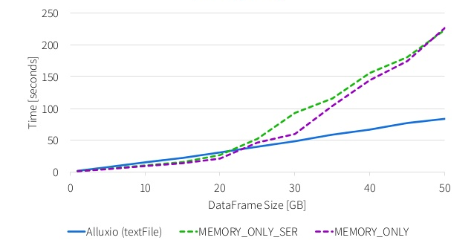
SPEED COMPARISON

Slide 24
Co-located compute and data with memory speed access to data
Distributed system,Scale out architecture
Software only ,no change needed to existing application
Virtualized across different storage systems under a unified namespace

Slide 25
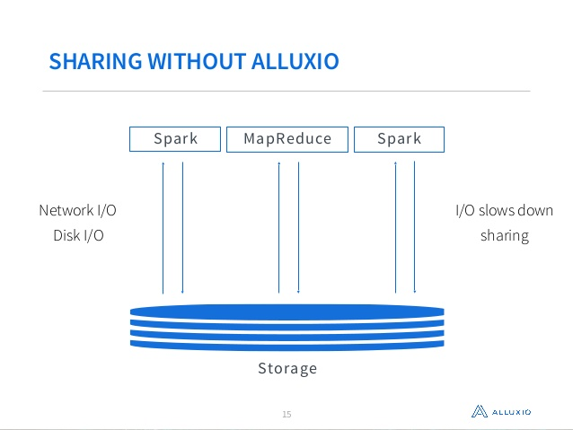
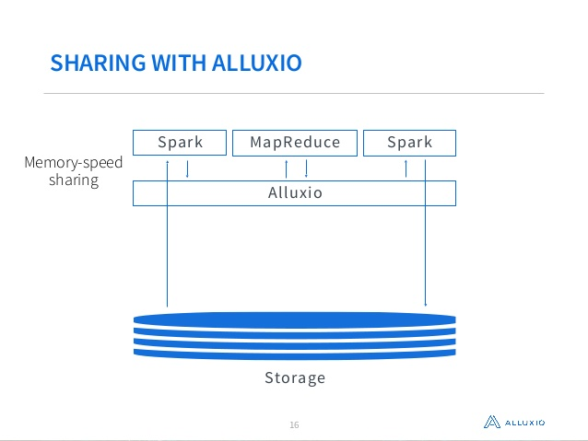

Slide 26
WHEN TO USE ALLUXIO?
When two or more jobs access the same dataset
Jobs may not always succeed
When there is large amount of data to process

Slide 27
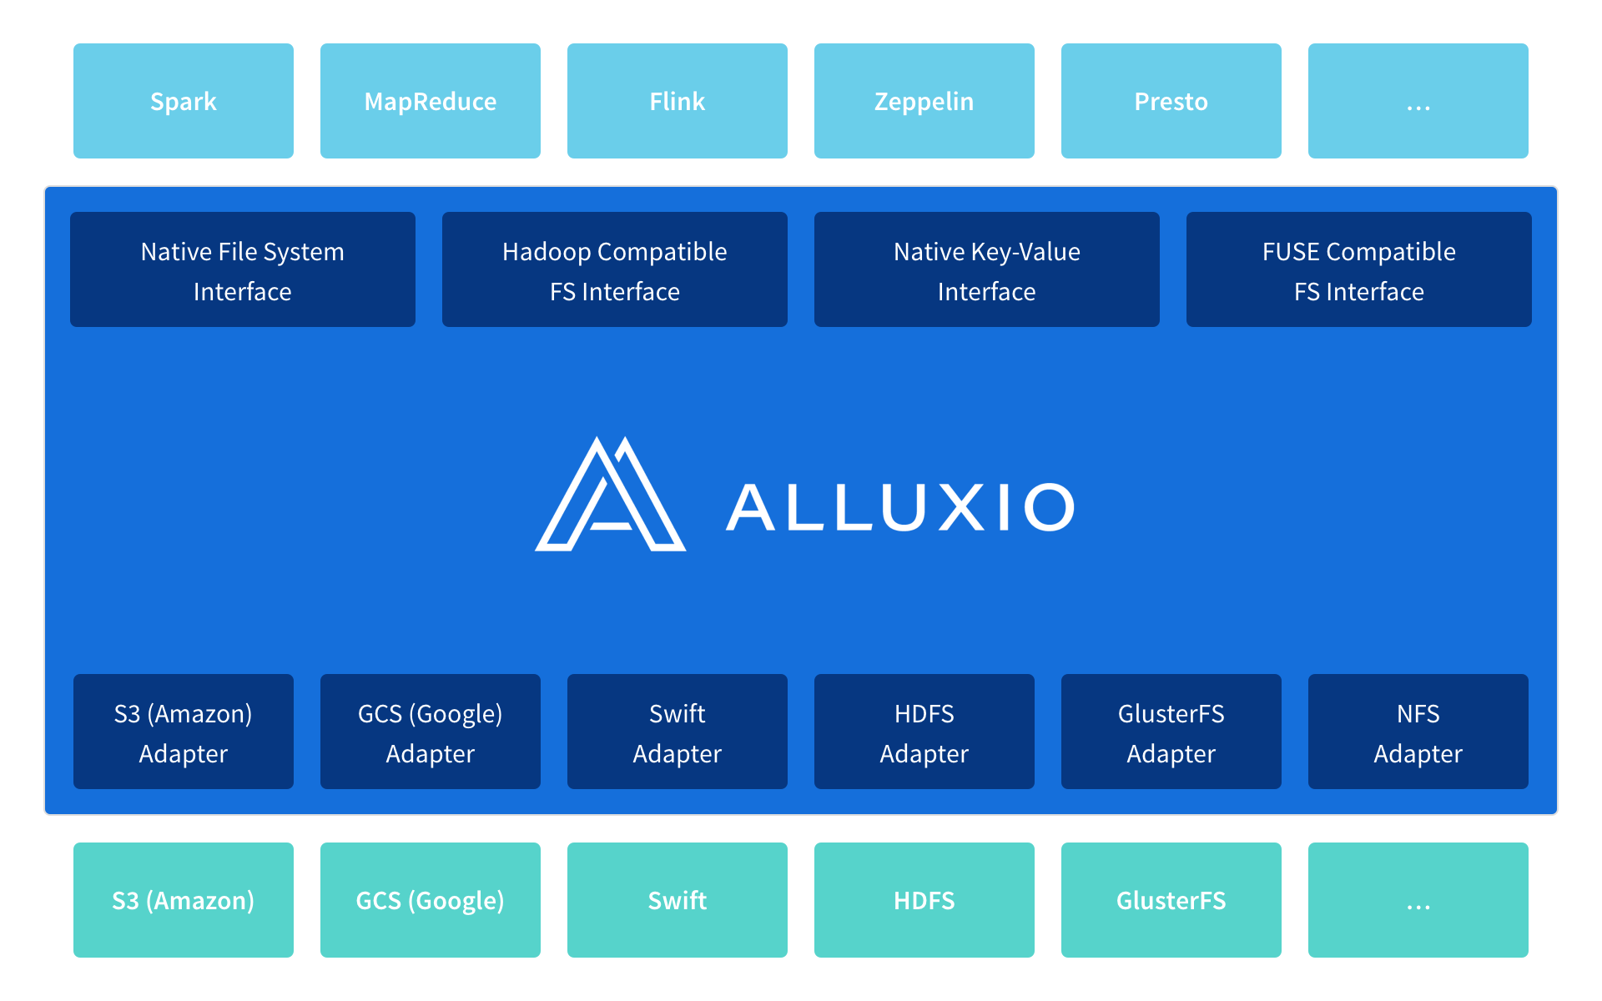
ALLUXIO ARCHITECTURE

Slide 28
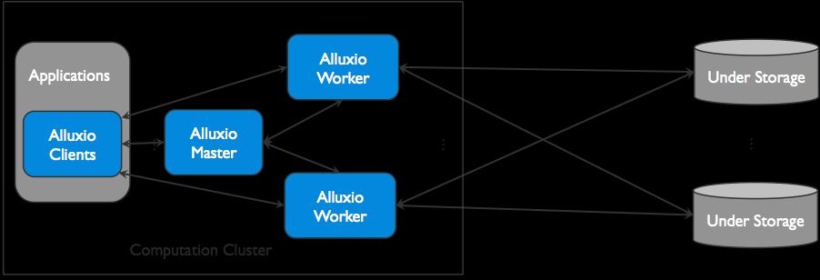

Slide 29
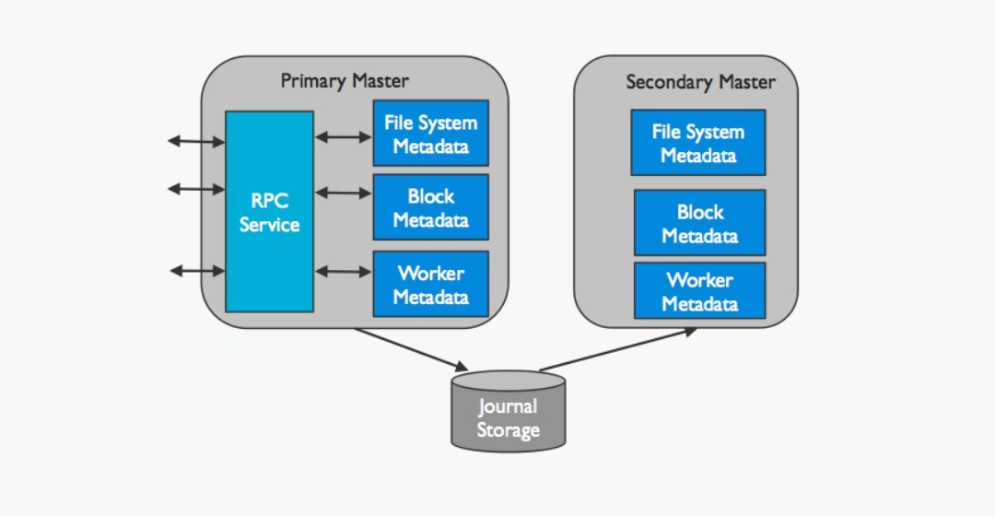
PRIMARY AND SECONDARY MASTER

Slide 30
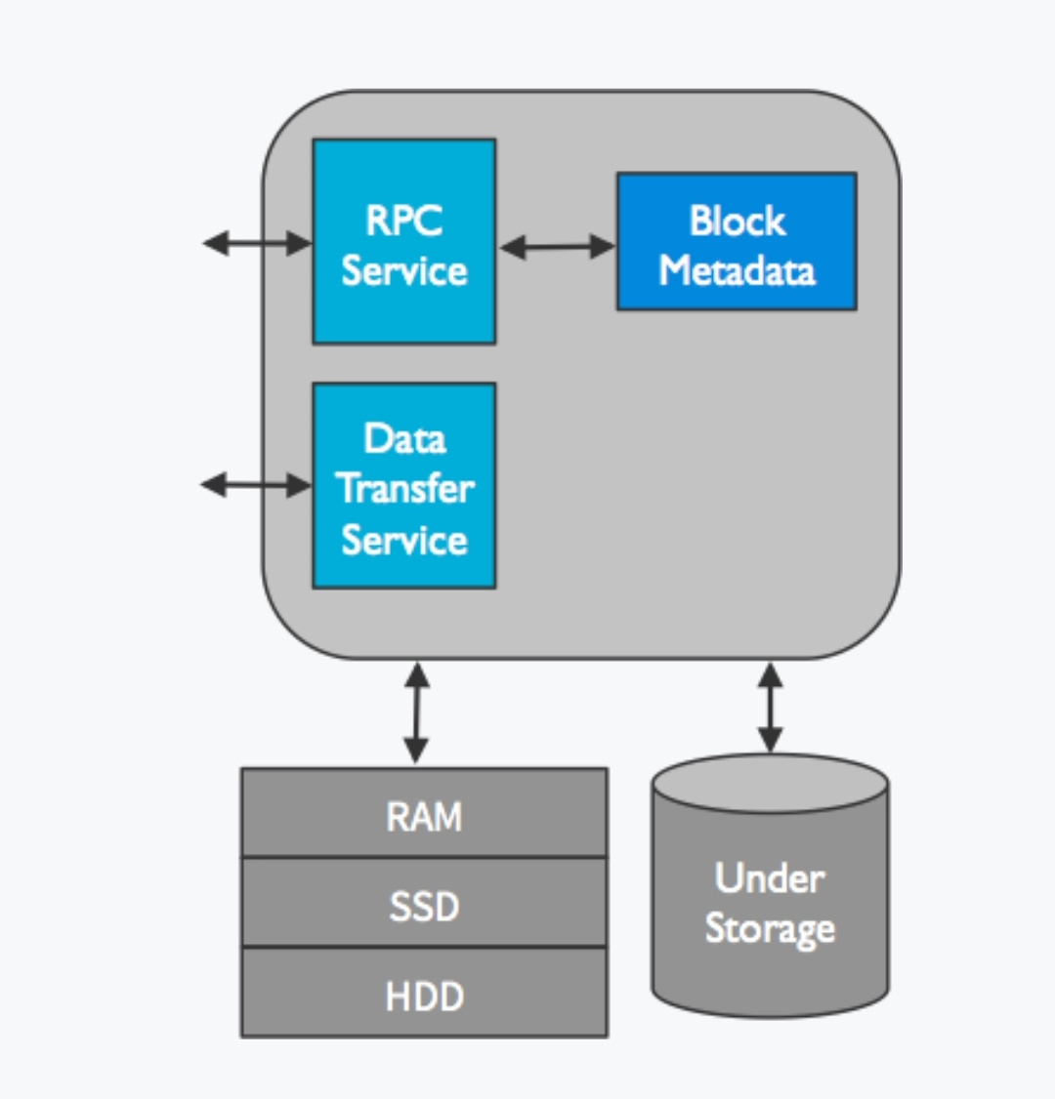
WORKERS IN ALLUXIO

Slide 31
Time configuration:
5sec → worker to master when start
10sec →worker to master 💓 beat
5min→ worker dead declare
1sec→ worker to worker 💓 beat
2min→ master to master 💓 beat
5min→ journal send
10min→ timeout primary master

Slide 32
BENEFITS OF ALLUXIO
1 Flexibility
2 Performance
3 Cost

Slide 33
FEATURES OF ALLUXIO
Unified namespace
Tiered storage
Transparent naming

Slide 34
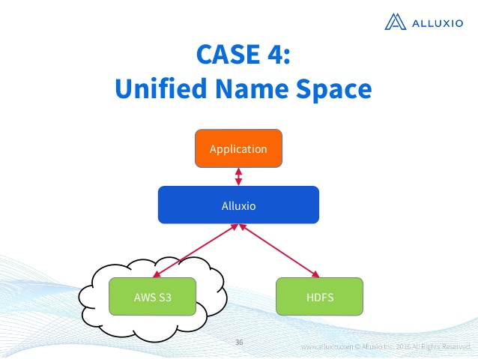
.

Slide 35
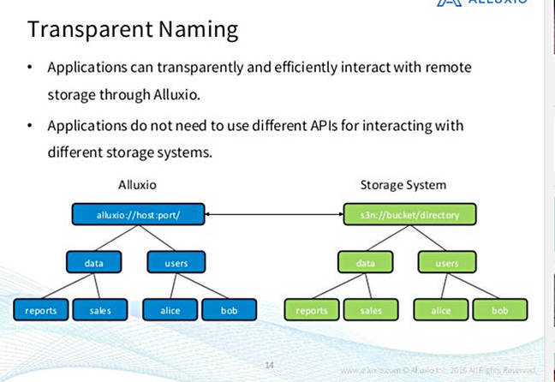

Slide 36
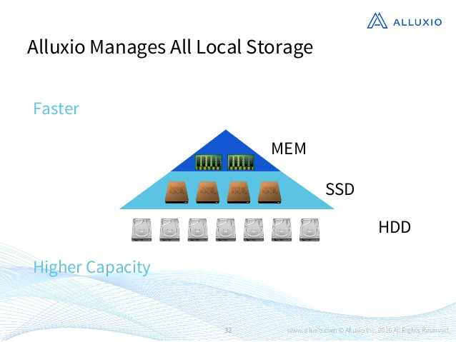
TIERED STORAGE

Slide 37
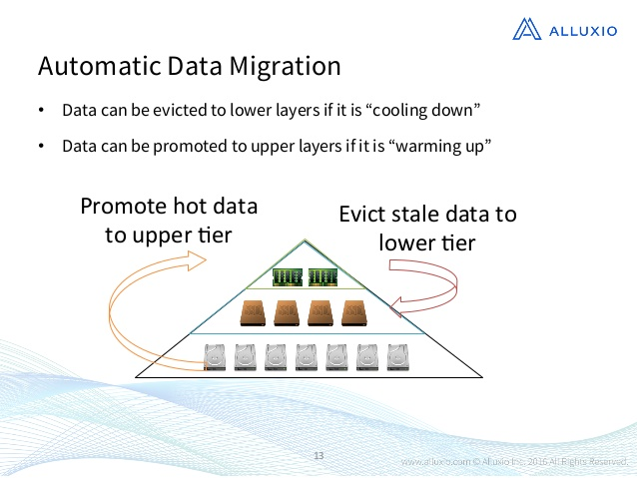

Slide 38
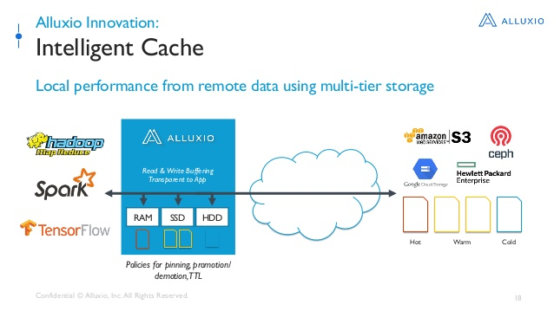

Slide 39
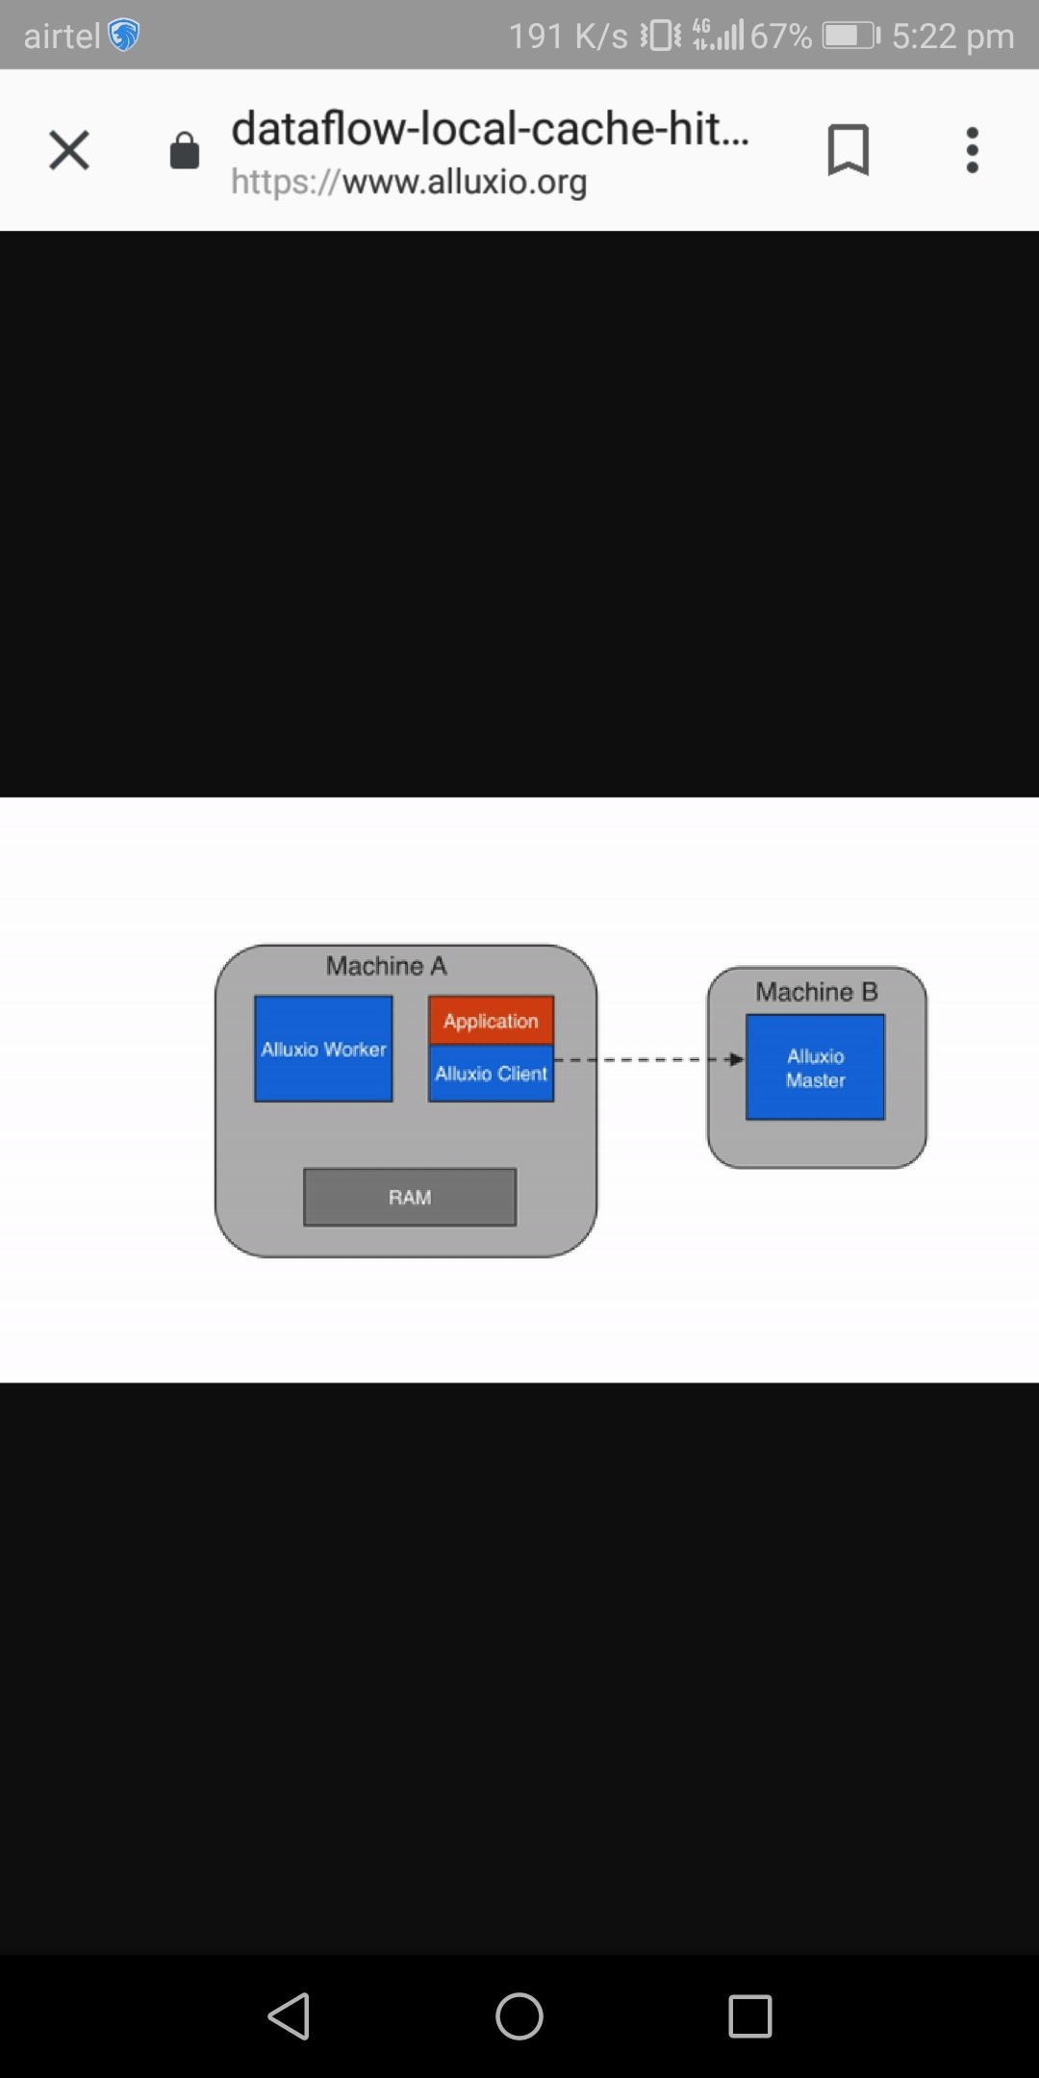


DATAFLOW IN ALLUXIO
Data Read
Local cache hit

Slide 40
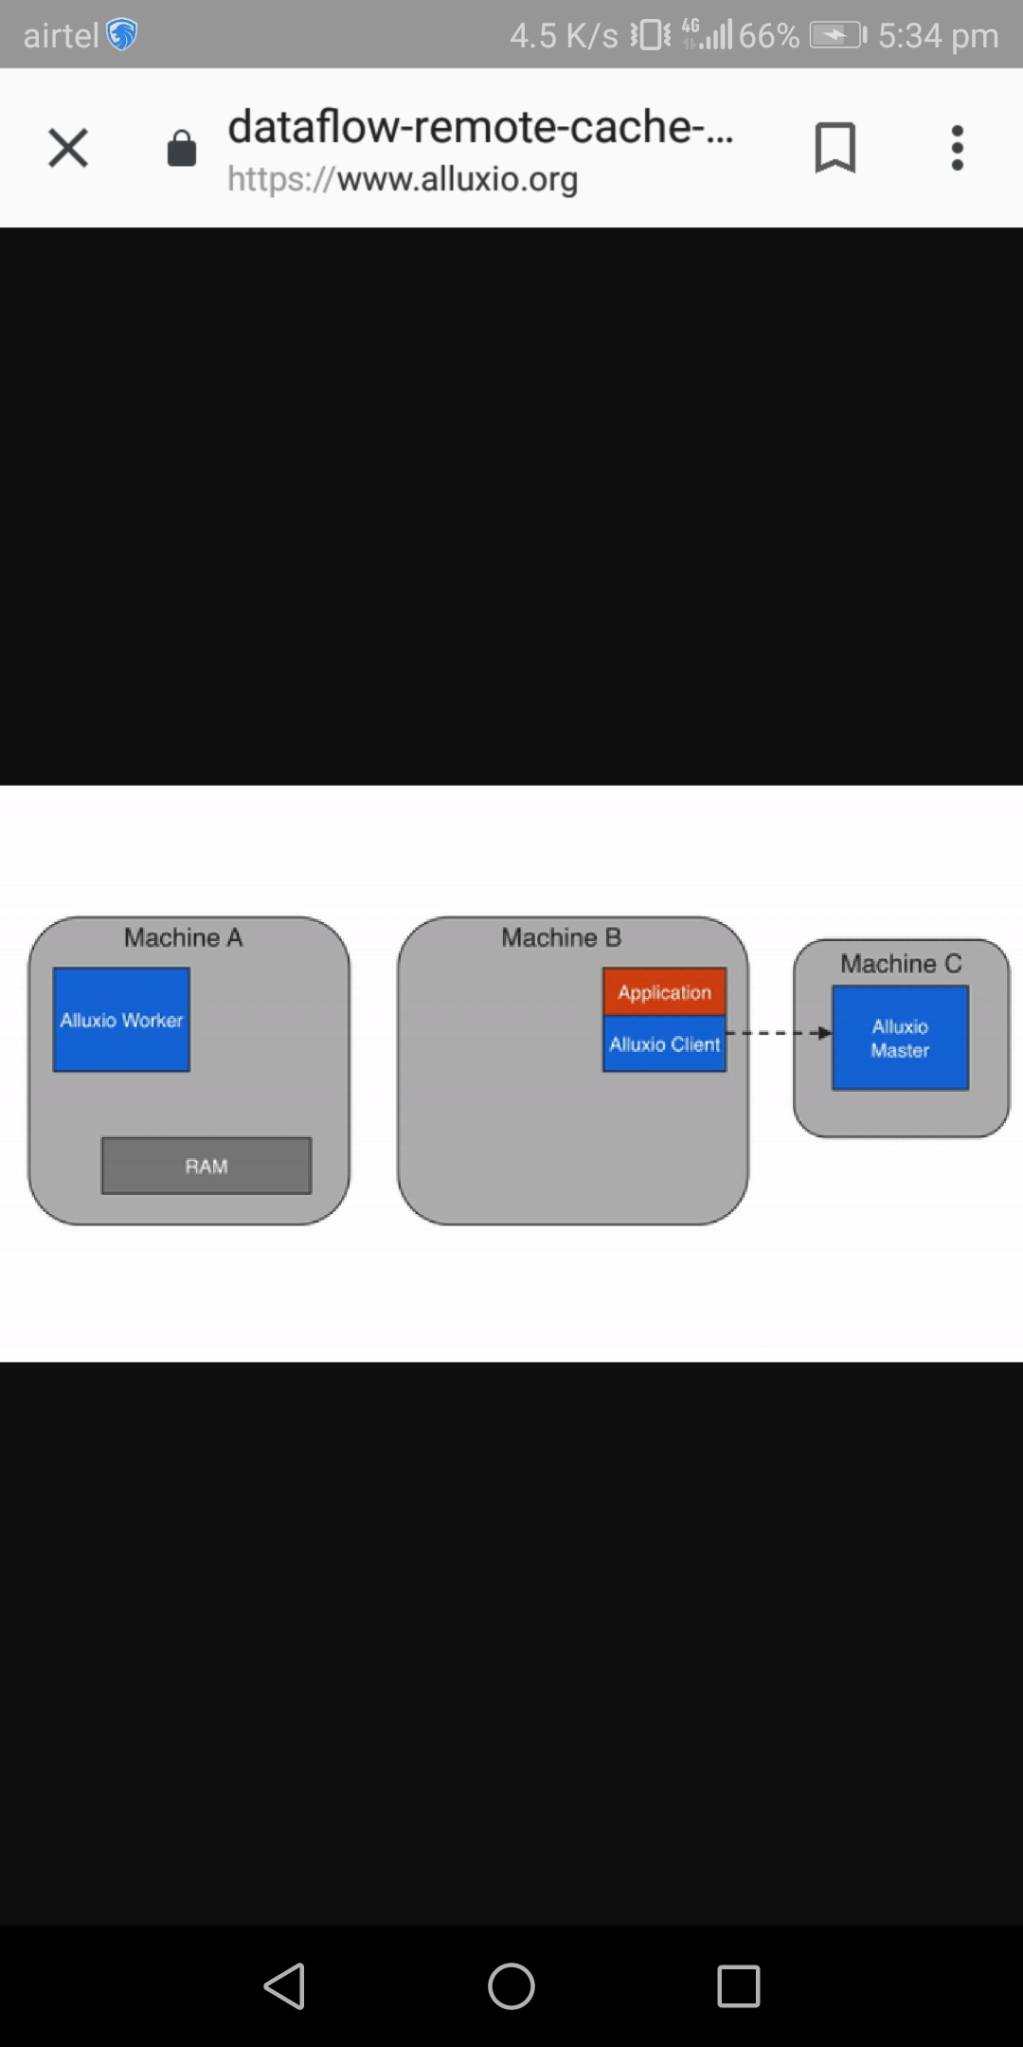

2)Remote cache hit

Slide 41



Slide 42
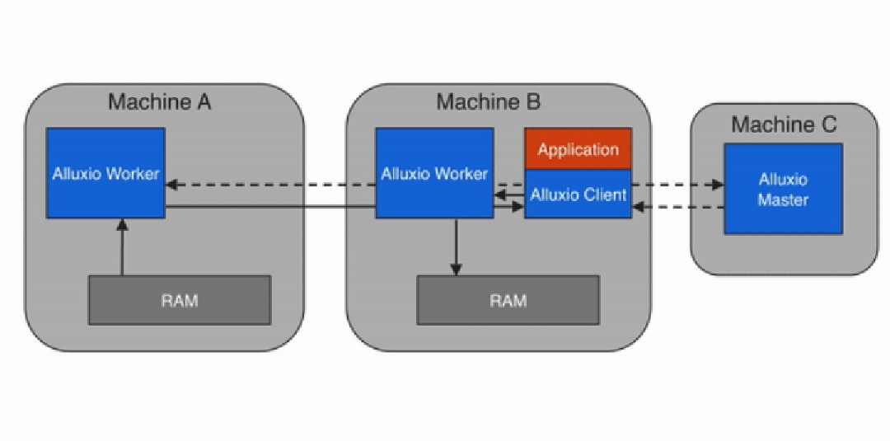

Slide 43
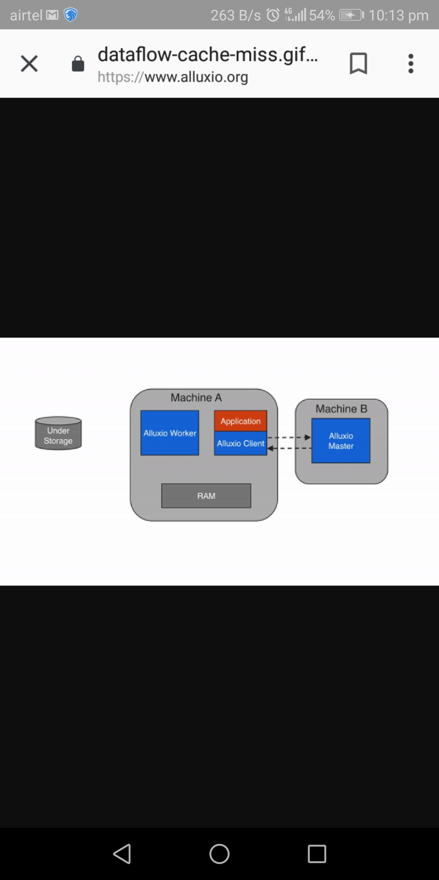
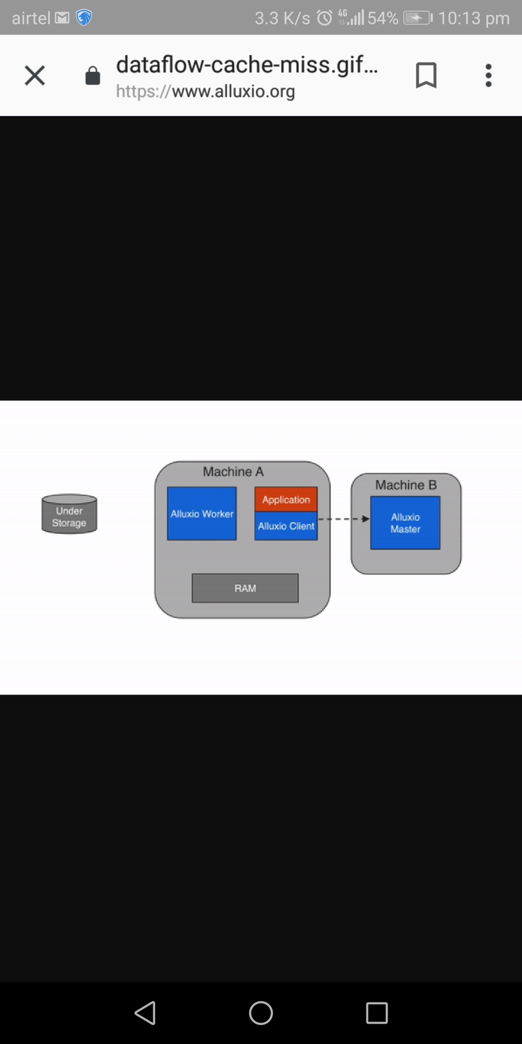

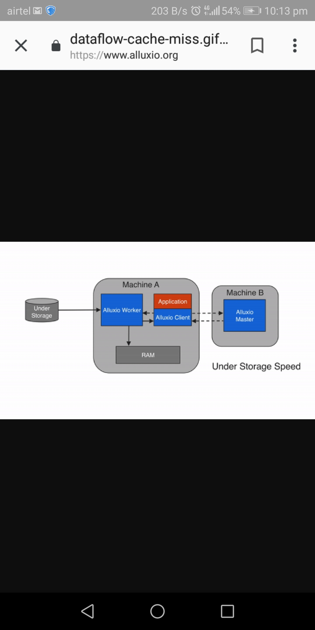
3) Cache miss

Slide 44
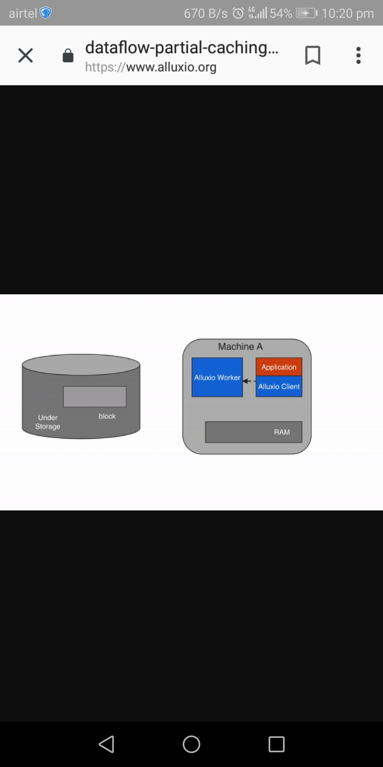
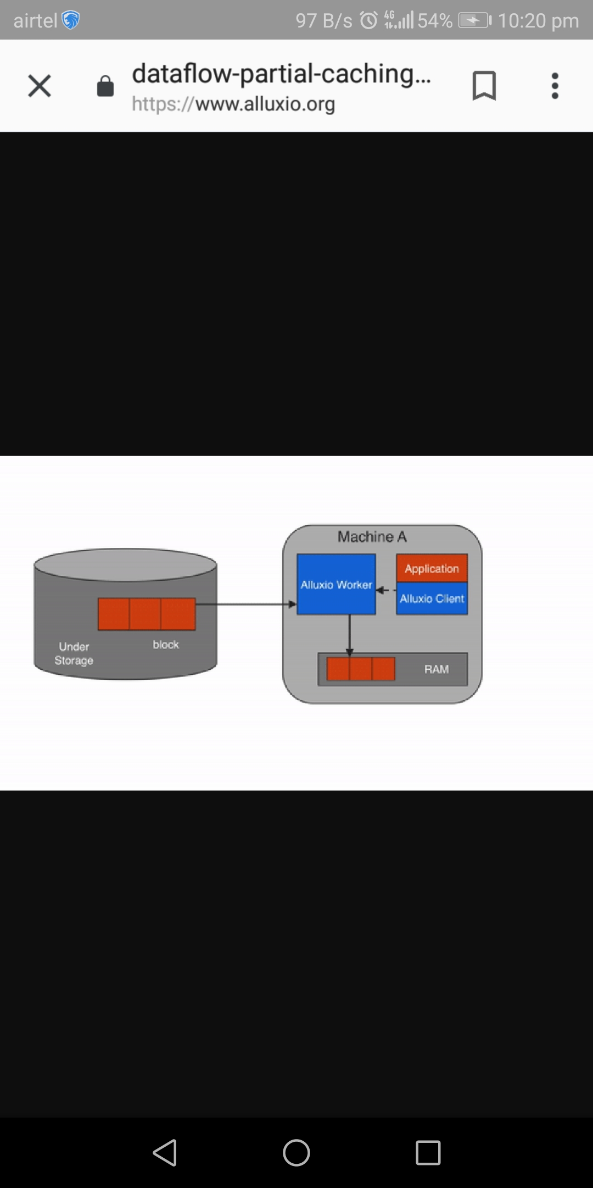
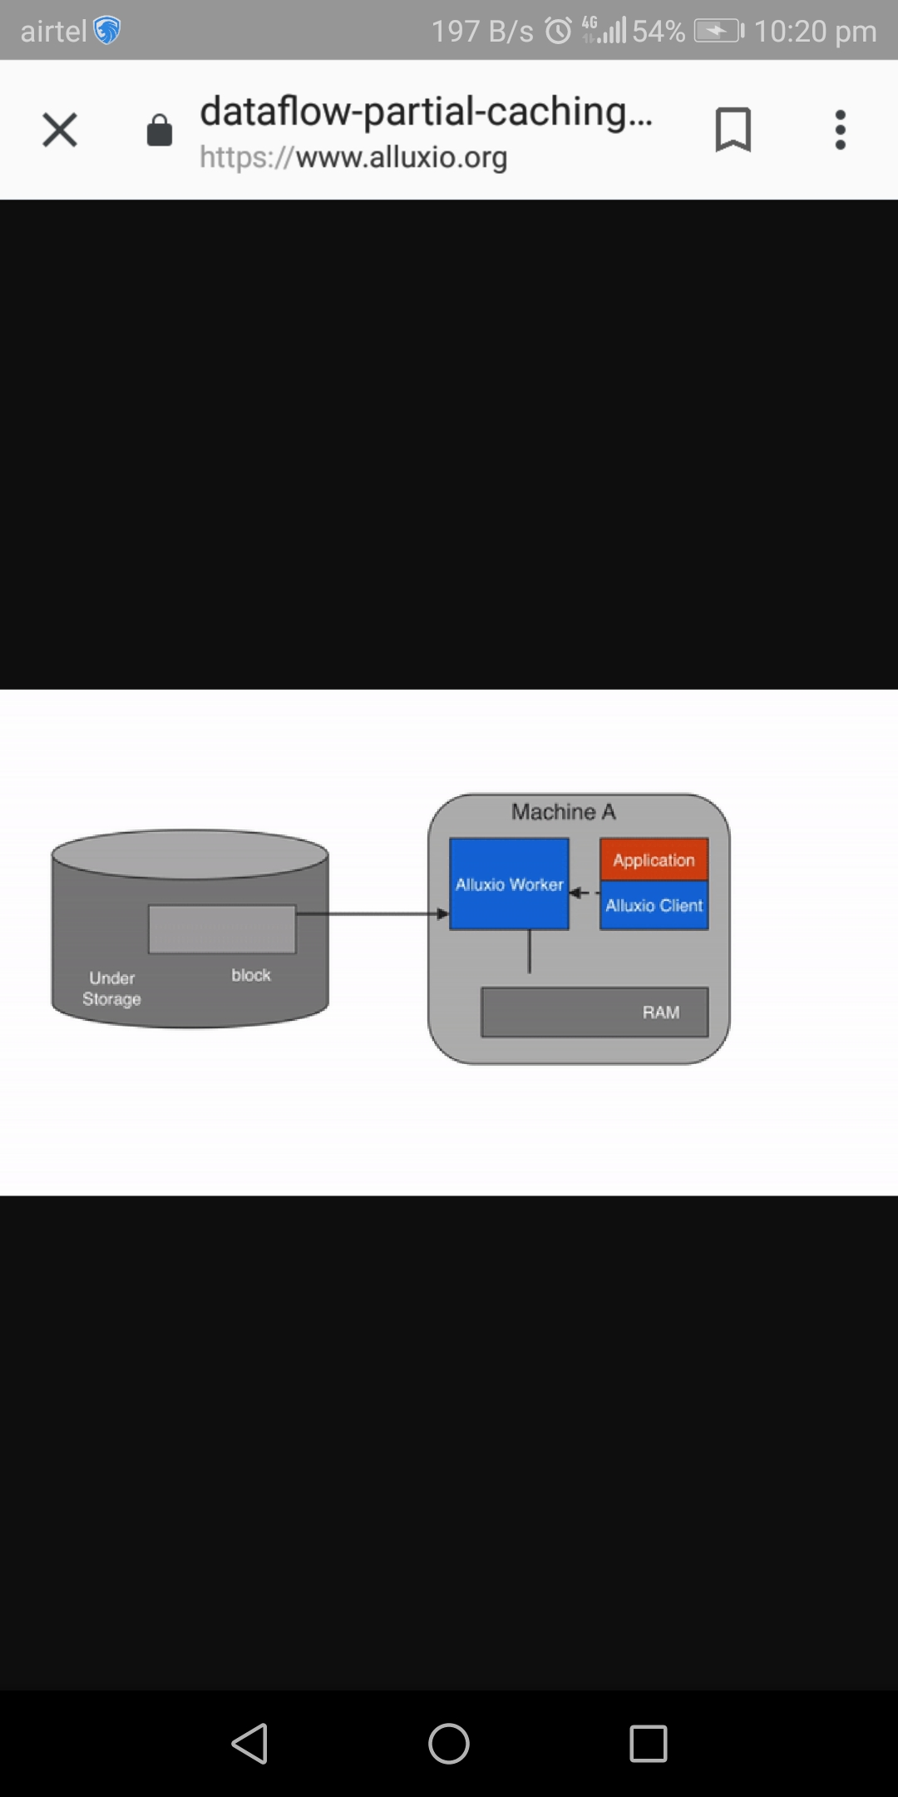

CACHING
partial caching-

Slide 45



No Caching
It's possible to turn off caching in Alluxio and have the client read directly from the under storage
DATA WRITE
MUST_CACHE (default)

Slide 46




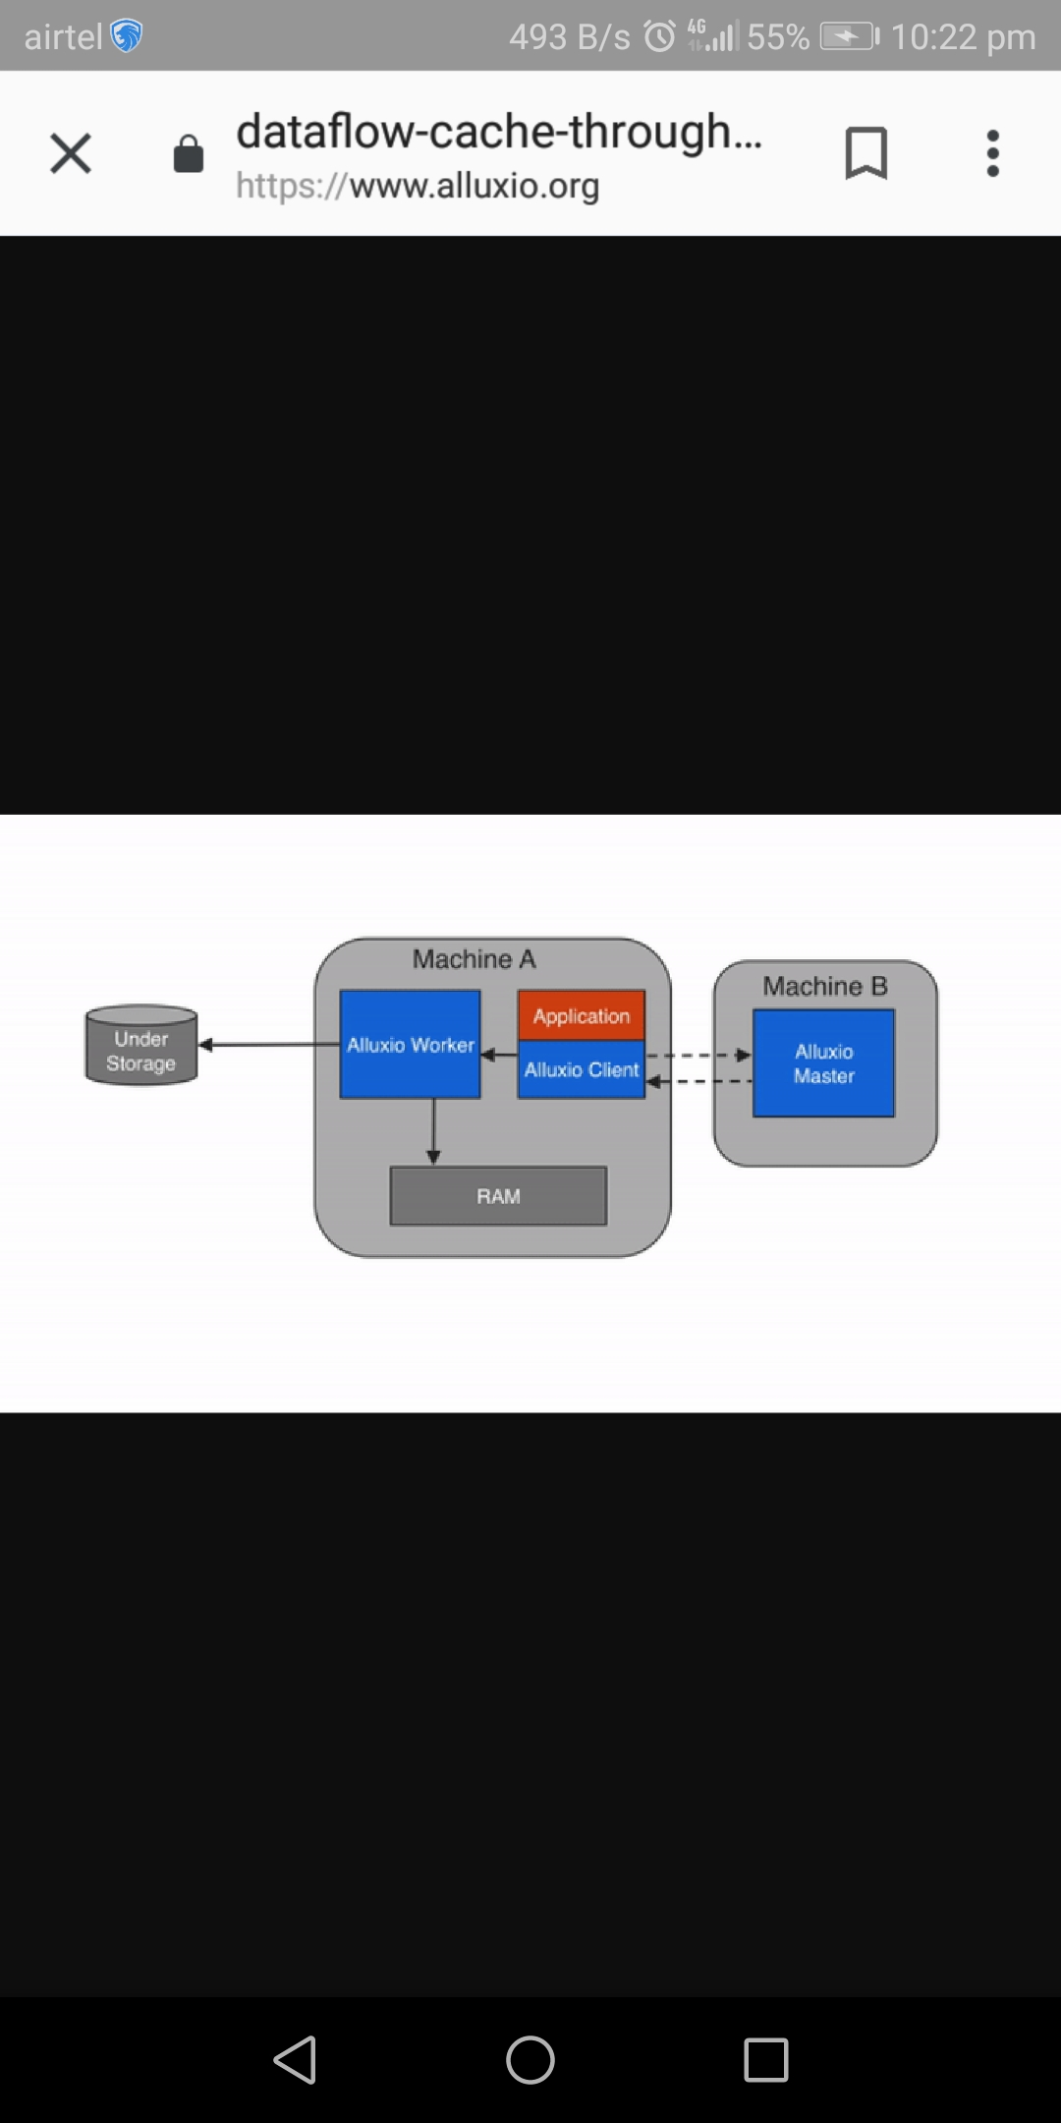
CACHE_THROUGH

Slide 47






ASYNC_THROUGH

Slide 48
INSTALLATION

Slide 49
DEMO CONTENT
Running a file from spark hdfs takes more time than running a file from alluxio and when it is hot then no time
Start-all.sh (file is stored in hdfs)
Spark-shell
Var rdd1 = textFile(“hdfs://localhost:9000/file”).count()

Slide 50
NOW FROM ALLUXIO
cd alluxio
nano file.txt
./bin/alluxio-start.sh local SudoMount
./bin/alluxio fs copyFromLocal file.txt /file1
Spark-shell
Var rdd1 = textFile(“alluxio://localhost:19998/file”).count()
// time is less (DEMO_1 COMPLETED)

Slide 51
DATA LOST TEST:::::
Ctrl-Z close spark shell
Now again start sparkshell
Compute with alluxio
DATA TIME IS NOT AS LONG AS IN CASE OF HDFS

Slide 52
Alluxio off data lost
Stop the alluxio and now if you
visit the alluxio
local host you will not be
able to find the file
in alluxio storage

Slide 53
THANK YOU :)
-Shashank Sahai
-Ripudaman Singh
-Anushka Chaudhary

